Slide 1
Microsoft Azure App Service – High Availability
Shimail Gillani
Cloud Solution Architect
Microsoft Education
Notes:
(Introductions and set expectations that this presentation is designed to discuss the role of Azure as the cloud computing platform for a business’s digital transformation.)

Slide 2




Shimail Gillani – Cloud Solution Architect ( aka @ChefGillani )
Recently Moved to Dallas, from New Jersey
Hybrid DevOps – 20+ Years (3 at Microsoft and Previously Ernst & Young)
MS Customer Success Unit - Solutions Architects team
Currently Helping:
Duke, U-Miami, U-South Florida, U-Texas,
Dallas and Minnesota – Colleges and University System
Previously Helped: Yale, Princeton, Johns Hopkins and U-North Carolina
Shimail.Gillani@Microsoft.Com Twitter: @ChefGillani GitHub: ChefGillani
Team Blog: https://blogs.msdn.microsoft.com/AzureEdu
Notes:
Technology is omnipresent. It’s shaping how businesses plan for innovation and growth within their markets. The importance of digital transformation is urgent; Since 2000, 52% of Fortune 500 companies are gone due to digital disruption.
We see companies responding by creating digital strategies across four core areas: engaging their customers, empowering their employees, optimizing their operations, and transforming their products.
Everyone is aware of how important this is. Look at a company like Uber for example. They’ve created a digital model for the taxi industry that has allowed them to surpass every other taxi company by double or more, recently valued at $62.5 Billion. They’ve created a significant shift in an industry that has been largely untouched for decades.

Slide 3
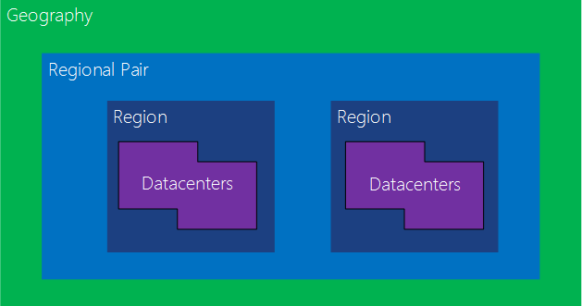
Azure Paired Regions for HA

Slide 4

North
West US
East US
South
Azure Paired Regions for HA

Slide 5
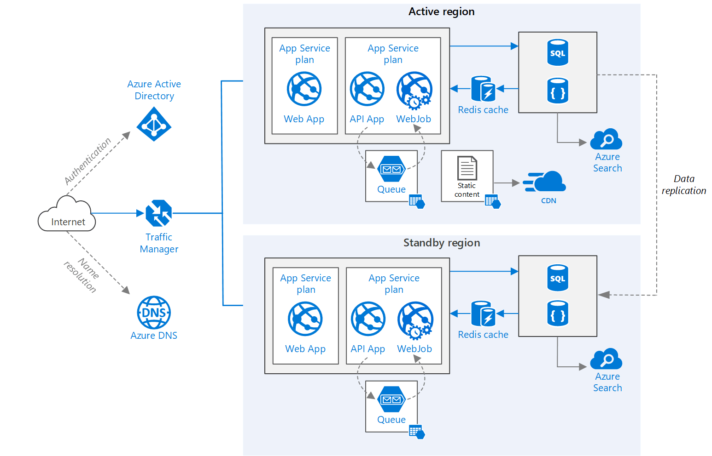
Multi Region App Service HA Architecture

Slide 6
Thanks for Joining
Shimail Gillani
Cloud Solution Architect
Microsoft Education
Notes:
(Introductions and set expectations that this presentation is designed to discuss the role of Azure as the cloud computing platform for a business’s digital transformation.)

